Slide 1
MEDLOGIC
Caring for You, Connected by Us

Slide 2
Introduction & Vision

Slide 3
The Problem: Bridging the gap between patients seeking timely medical advice and doctors aiming to manage their practice efficiently in a digital world.
Our Solution: An integrated, secure, and user-friendly platform for seamless online and offline medical consultations.
Our Vision: To make quality healthcare accessible, manageable, and convenient for everyone, anywhere.

Slide 4
THE TEAM MEMBERS

Slide 5
❤️
KARTHIKEYA CHUNDURU
CSE 3RD YEAR
VARANASI ADITYA
CSE 1ST YEAR
👩‍⚕️
PRANEETHA VARANASI
CSE 3RD YEAR
SUNAND CHOUDARY V
CSE 1ST YEAR
GAURANG P KHASNE
CSE 1ST YEAR
SAI SRIHITHA PICHIKA
CSE 1ST YEAR
🏥
👩‍⚕️
🏥
❤️

Slide 6
Medilogic
Stepwise walkthrough, design observations.

Slide 7
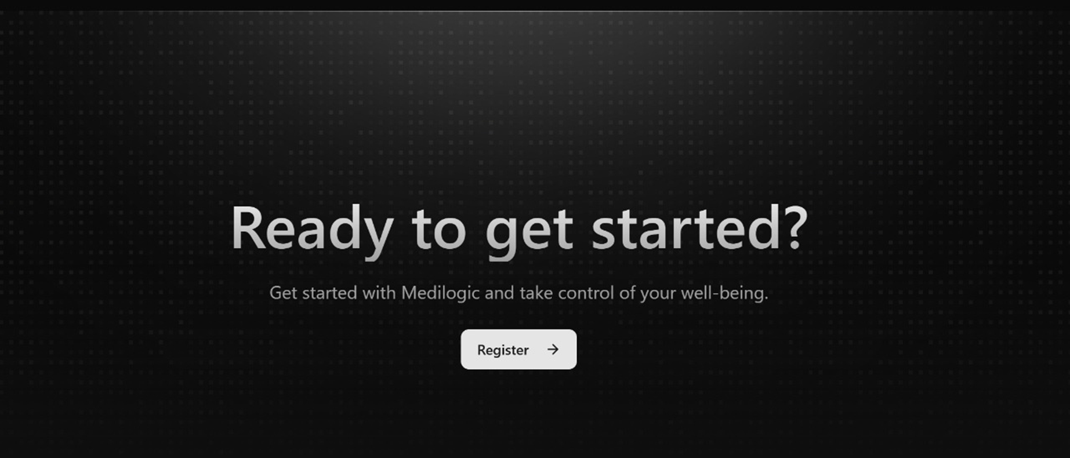
Hero & Call To Action

Slide 8
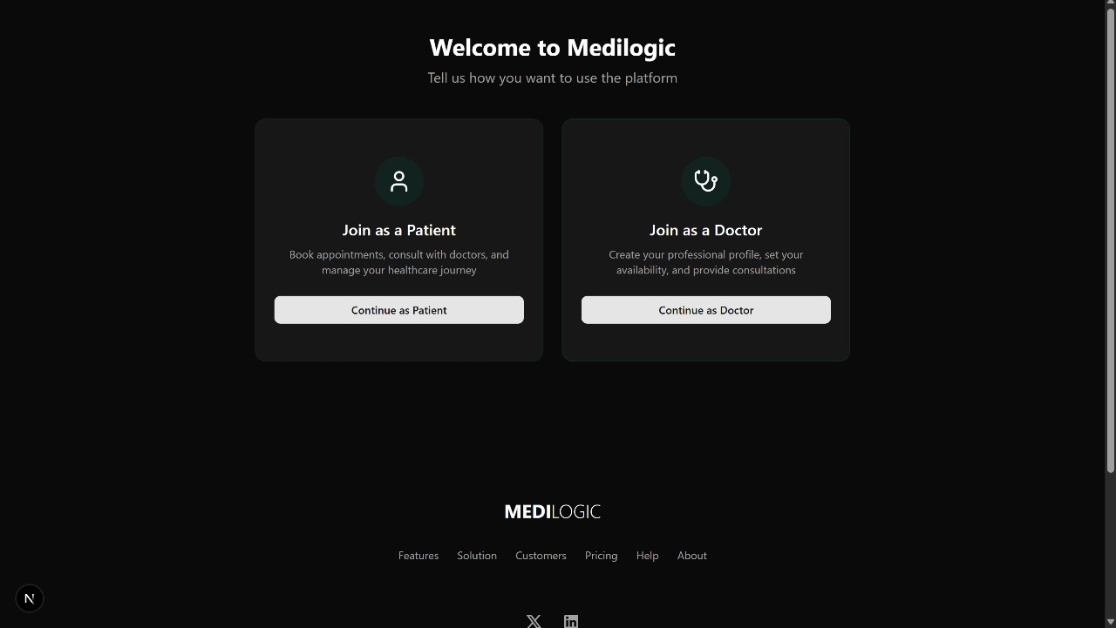
Brand & Visual Identity

Slide 9
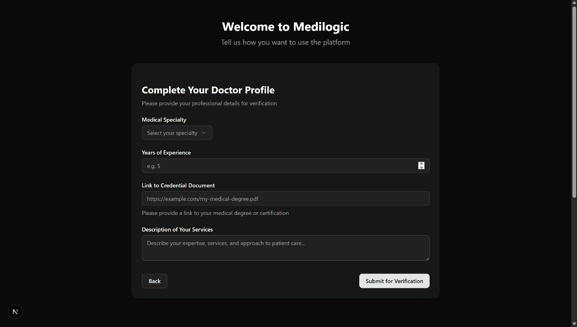

Slide 10
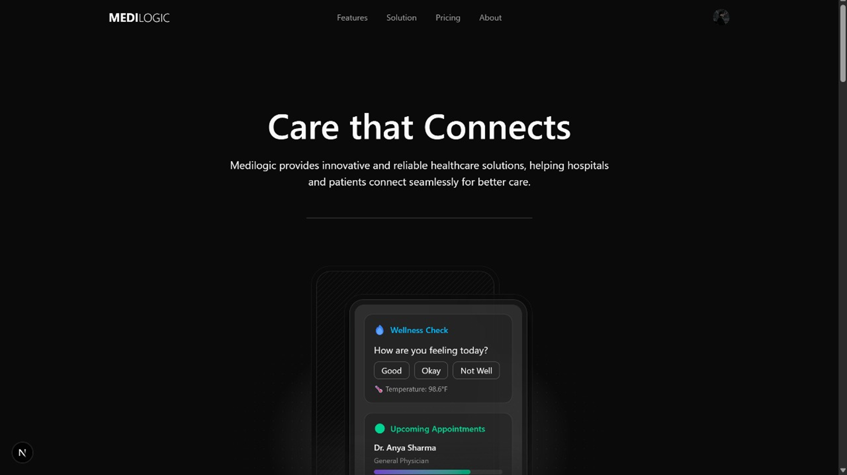
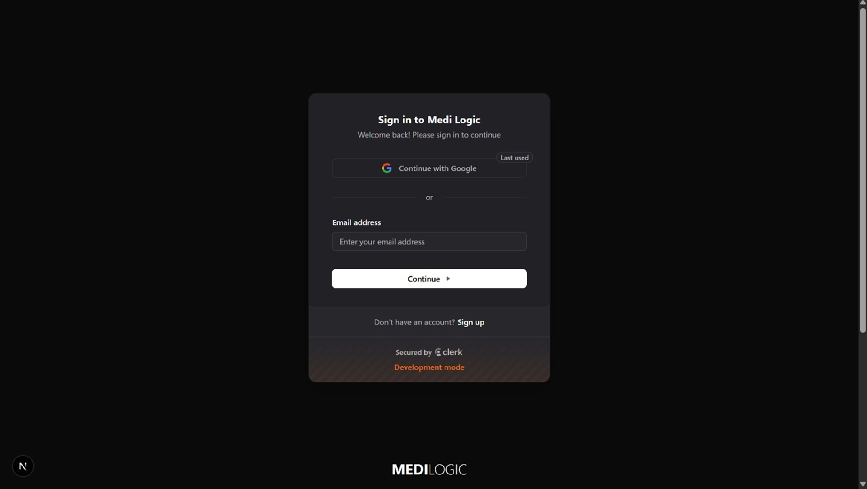
Sign-in Flow & Onboarding

Slide 11
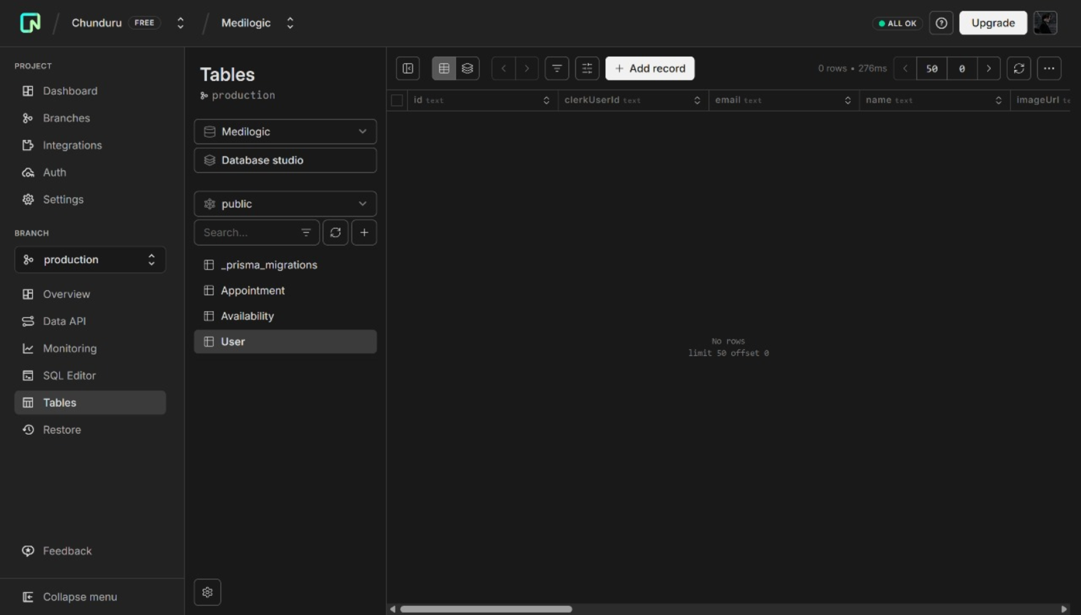
Admin & Data Management
Admin view (Database studio) shows tables: Appointment, Availability, User, migrations.
Action: highlight privacy/data governance, role-based access control, and backup strategy.

Slide 12
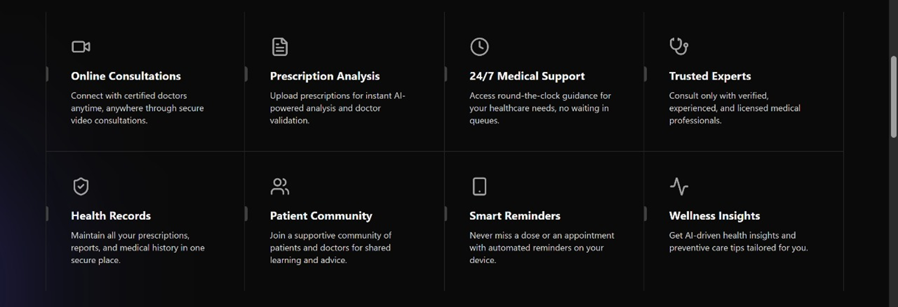
Main Features

Slide 13
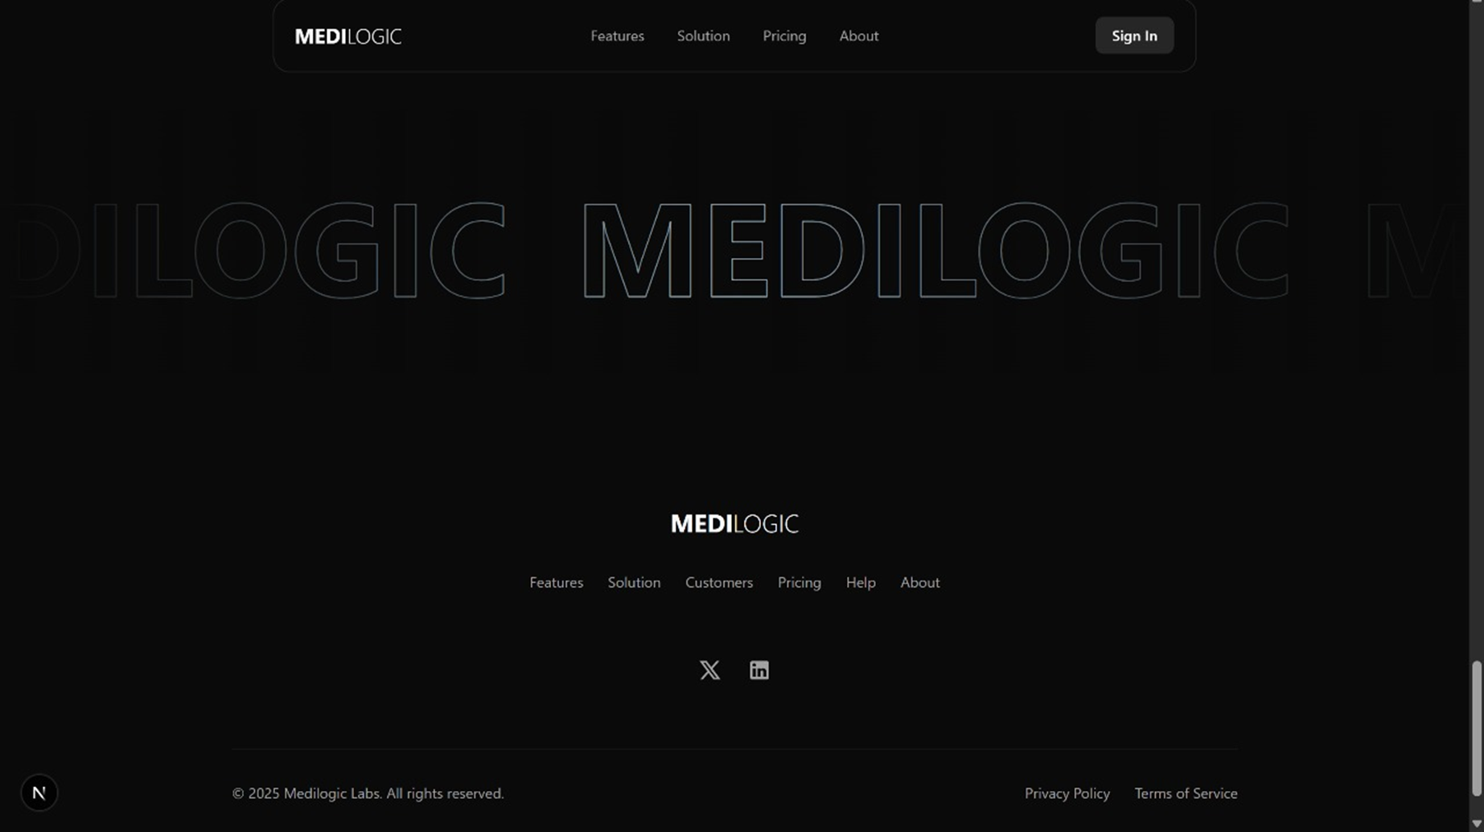
Brand & Visual Identity

Slide 14
Our User Ecosystem
A platform designed for every stakeholder in the healthcare journey.

Slide 15

📋
🔍
💊
Patients: Individuals seeking medical care and actively managing their health records.
Doctors: Healthcare professionals providing expert consultations and managing their patient base efficiently.
Admin: The operational team responsible for overseeing, managing, and ensuring the smooth functioning of the platform.

Slide 16
Empowering the Patient

Slide 17
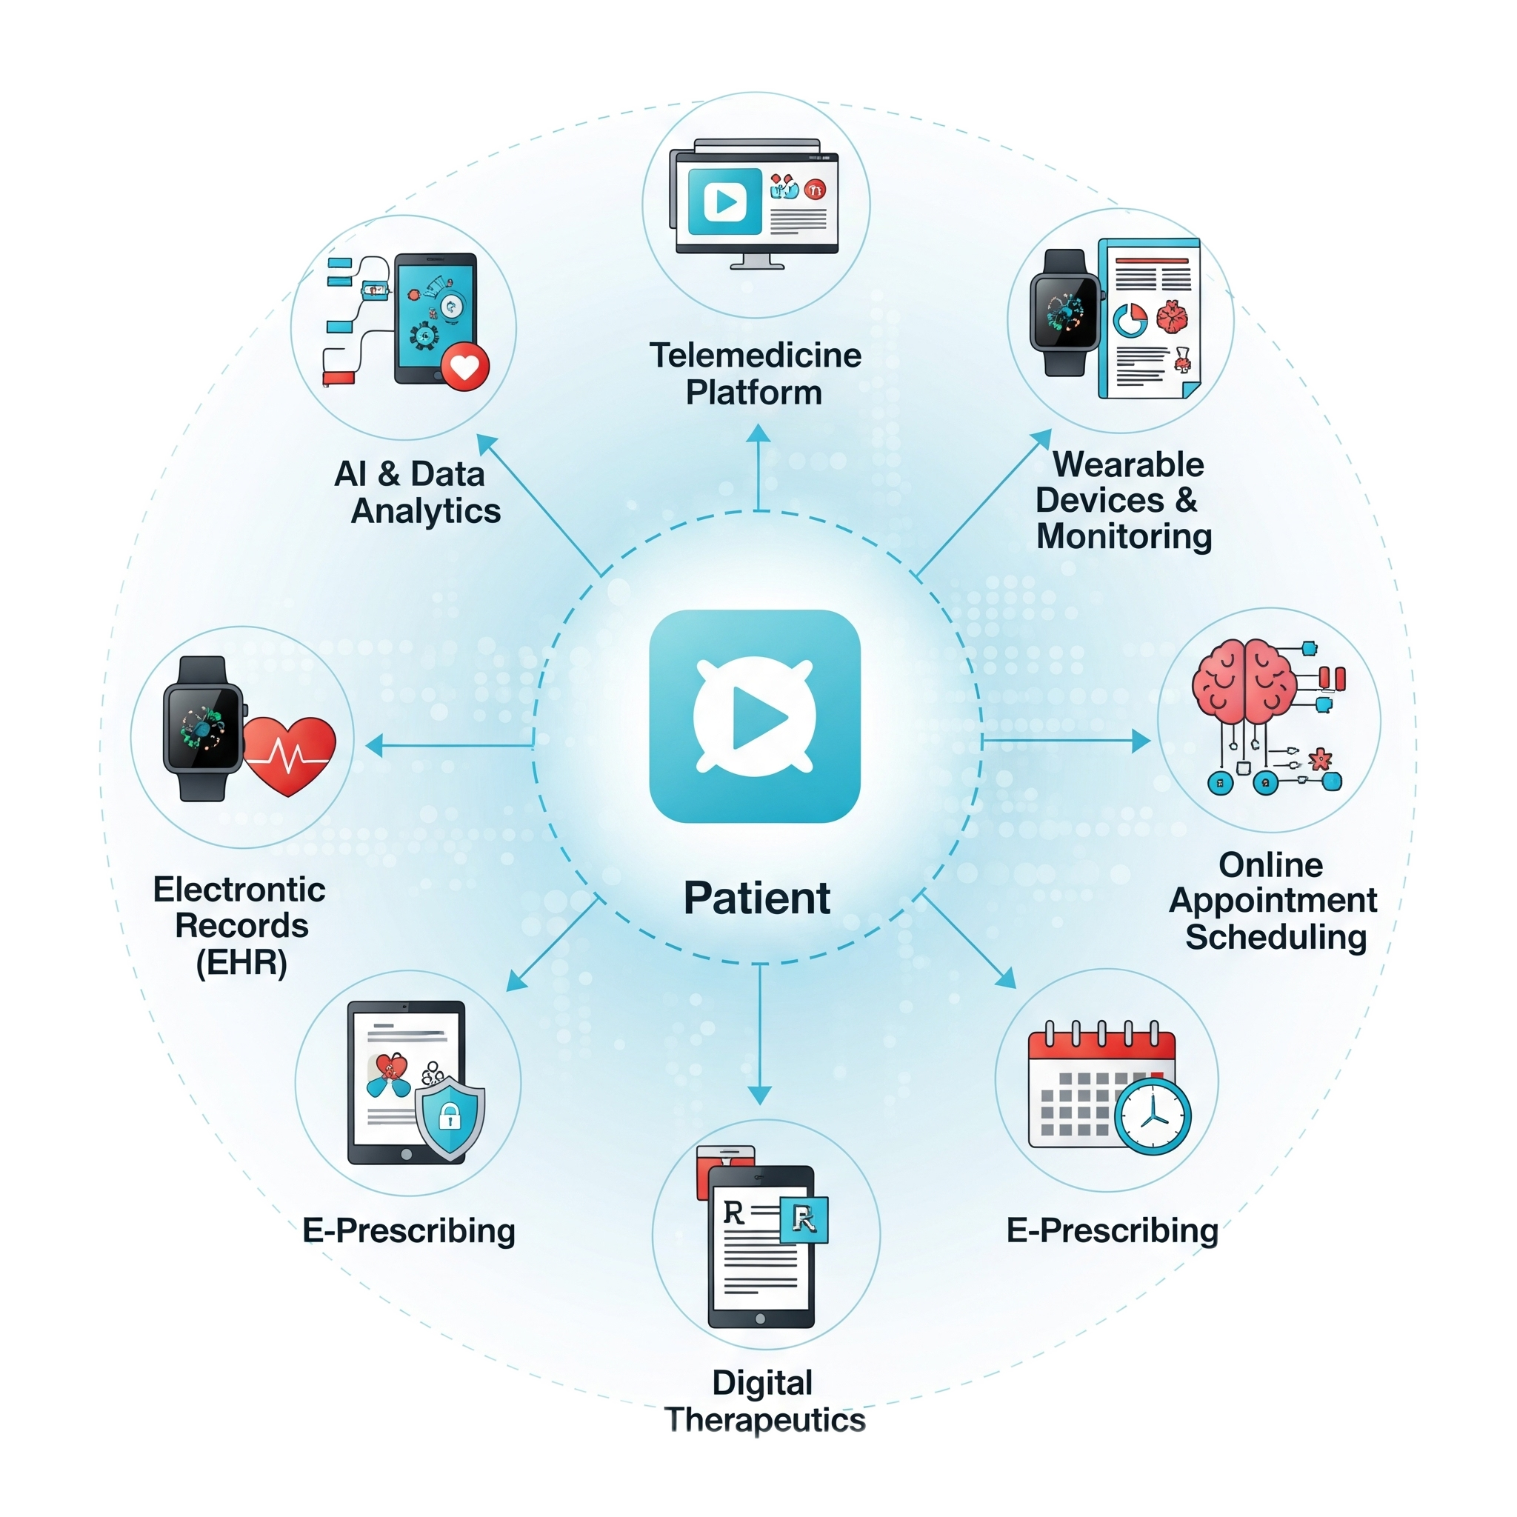
🧑‍⚕️
📅
💻
Profile Management: Create and manage a comprehensive personal health profile.
Find Your Doctor: Use advanced search and filters to find the right specialist.
Flexible Booking: Easily schedule appointments for both online video calls and offline in-clinic visits.
Secure Consultations: Engage in high-quality, private video calls with trusted doctors.
Unified Health Records: Upload medical reports and instantly access digital prescriptions.
Simple & Secure Payments: Hassle-free online payment processing for all services.

Slide 18
Equipping the Doctor

Slide 19

Professional Digital Profile: Showcase specialization, experience, and qualifications to build patient trust.
Intelligent Schedule Management: Set availability, manage your calendar, and prevent booking conflicts.
Total Appointment Control: Review, accept, or reject incoming appointment requests with a single click.
Virtual Clinic:Conduct video consultations from any location, expanding your reach.
E-Prescriptions: Generate and share secure, digital prescriptions directly with patients.
Informed Decision-Making: Access complete patient medical history and reports at your fingertips.

Slide 20
Core Platform Features
🔒 Authentication
Secure Login & 2FA
💬 Consultation Tools
Video Calls & Chat
📂 Data Management
Secure & Compliant

Slide 21
ADDITIONAL FEATURES

Slide 22
User can upload the prescription, the dosage and the amount of medicine will be defined.
Detailed description of drug is given through an ai chatbot

Slide 23
Our Technology Stack
A robust and scalable architecture

Slide 24







🔒
📑
🛡️
Frontend: React / Cronjob/ShadCn UI
UI/UX Framework: Tailark
Backend: Node.js/Next.js/zod/react hook form
Database: Prisma/Neondb
Video & Chat SDK: Voyage.js
Deployment & Hosting: netlify.com

Slide 25
THANK YOU!

